Slide 1
Internet stvari i servisa
Filip Dojčinović
18135

Slide 2
Sadržaj
Sensor
Analytics
EventInfo
Primer

Slide 3



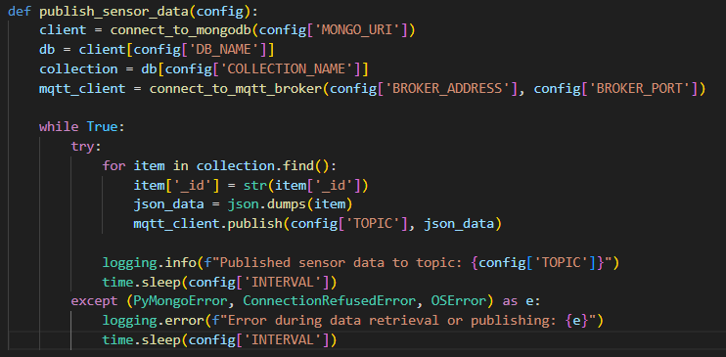

Sensor microservice
Retrieve data
publish ‘’sensor/data’’
MQTT Broker

Slide 4
Analytics Microservice
Summary of the current situation.
Use brief bullets, discuss details verbally.

Slide 5
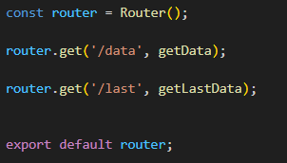
EventInfo

Slide 6
Docker
State the alternative strategies.
List advantages & disadvantages of each.
State cost of each option.

Slide 7


